Slide 1
Machine Learning 2 Project
Sergio Cárcamo Jara (466116)

Slide 2
Overview
Data Description
Data Specificity
Training/Test Data Division
Comparison of Methods
Summary and Conclusions
Questions

Slide 3
Pediatric Appendicitis
Classification

Slide 4
Data description
Data corresponds to pediatric patients with suspected appendicitis admitted with abdominal pain to Children’s Hospital St. Hedwig in Regensburg, Germany, between 2016 and 2021. The dataset includes ultrasound images, laboratory, physical examination, scoring results and ultrasonographic findings extracted manually by the experts, and the target variable is diagnosis, to predict if the patient has appendicitis or not.
Notes:
Clear description of the source and problem analyzed.

Slide 5
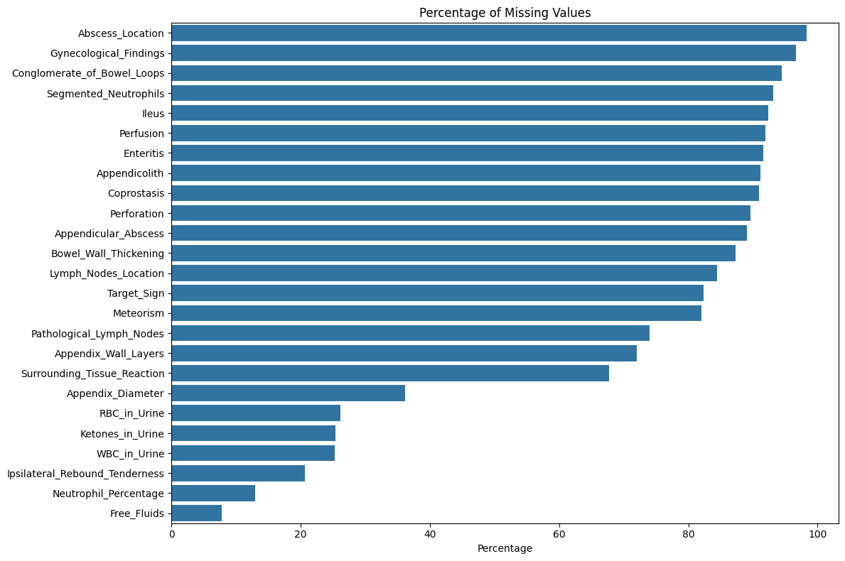

Slide 6
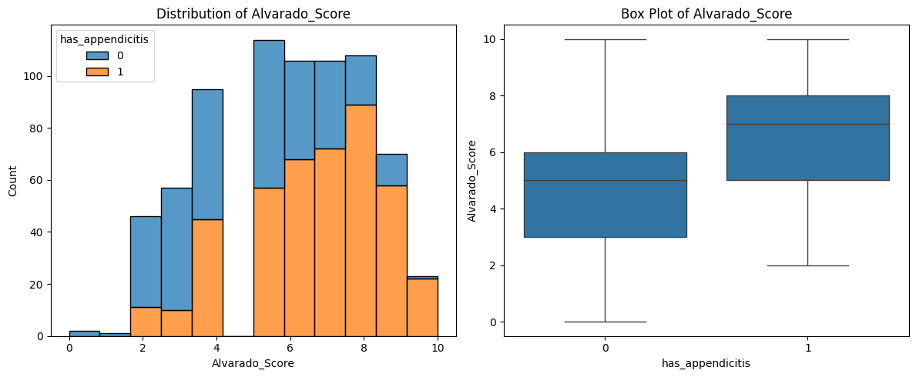
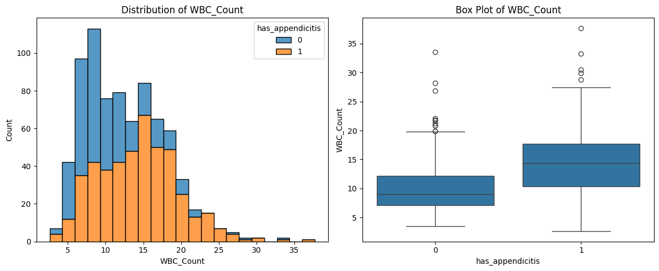
The Alvarado score is a clinical scoring system used in the diagnosis of appendicitis. Based on symptoms and blood test results.
WBC: White blood cell count

Slide 7
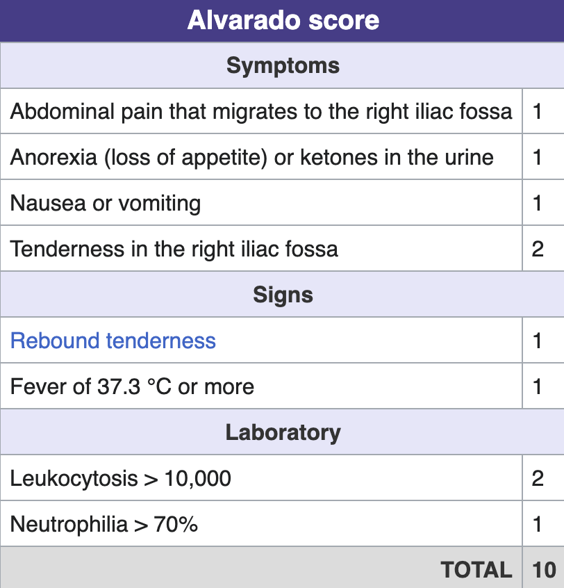

Slide 8
Training/Test Data Division
Training/Test data split 80/20
Randomized Search CV
parameters set for each model
25 iterations
scoring F1
cv 5

Slide 9
Comparison of Methods
model | RandomForestClassifier | AdaBoostClassifier | XGBClassifier
accuracy | 0.929487 | 0.974359 | 0.948718
precision | 0.94186 | 0.977011 | 0.964706
recall | 0.931034 | 0.977011 | 0.942529
F1 | 0.936416 | 0.977011 | 0.953488
Notes:
Precision (True positives / Predicted positives)
Recall (True positives / Actual positives)
F1 Score (Harmonic mean of precision and recall)

Slide 10
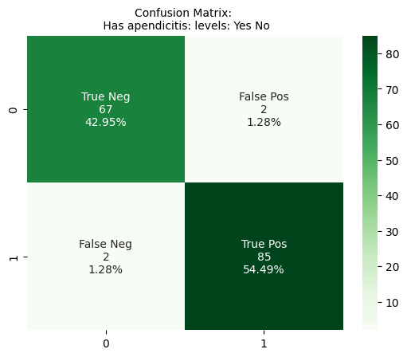
AdaBoost Classifier
Notes:
Lowest false positives and negatives

Slide 11
Summary and Conclusions
Chosen model is AdaBoost Classifier (with Decision Tree Classifier as base estimator)
Find variables that can be removed without sacrificing performance (such as ultrasound images)
Improve imputation methods
Best hyper parameters
algorithm: SAMME
learning_rate: 0.63435404
n_estimators: 111
imputer: mean
estimator criterion: entropy
estimator max_depth: 7
estimator min samples leaf: 3
estimator min samples split: 3
Notes:
SAMME (Stagewise Additive Modeling using a Multi-class Exponential loss) is an algorithm used in multiclass classification for boosting weak learners (typically decision trees) into a strong ensemble classifier. SAMME is an extension of the AdaBoost (Adaptive Boosting) algorithm and is designed to handle problems with more than two classes.

Slide 12
Real estate prices
Regression

Slide 13
Data description
For the regression problem, the data was scraped from otodom from september to december 2024. The scope is properties for sale in the Warsaw area, including flats, excludes houses. The dataset includes data on the property itself, and the building if the property is a flat. The target variable is the price.
Notes:
Clear description of the source and problem analyzed.

Slide 14
Data description
Property characteristics:
estate: FLAT, HOUSE
area_m2
rooms_number
floor_number
windows_type
heating
price
Location
district
latitude
longitude
Building characteristics:
building_year
building_age
building_type
building_floors_num
construction_status
building_material
building_ownership
Notes:
Clear description of the source and problem analyzed.

Slide 15
Data description: amenities
has_lift
has_internet
has_furniture
has_air_conditioning
has_tv
has_oven
has_stove
has_dishwasher
has_fridge
has_washing_machine
has_separate_kitchen
has_garage
has_usable_room
has_terrace
has_balcony
has_attic
has_basement
has_garden
has_pool
Notes:
Clear description of the source and problem analyzed.

Slide 16
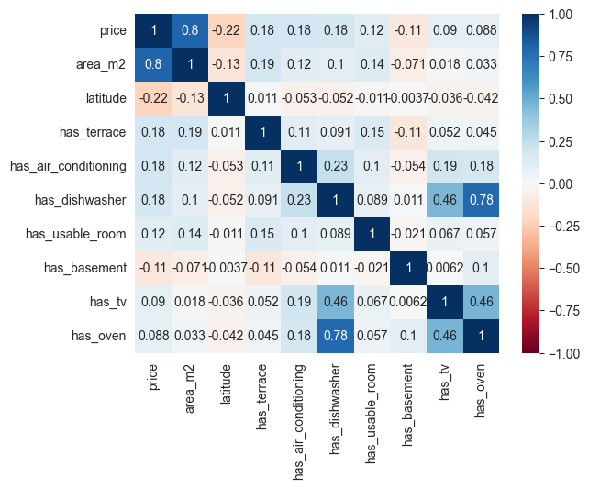
Notes:
Clear description of the source and problem analyzed.

Slide 17
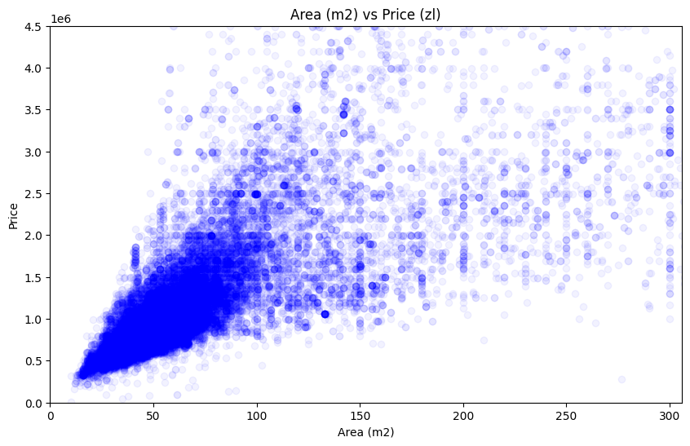
Notes:
Clear description of the source and problem analyzed.

Slide 18
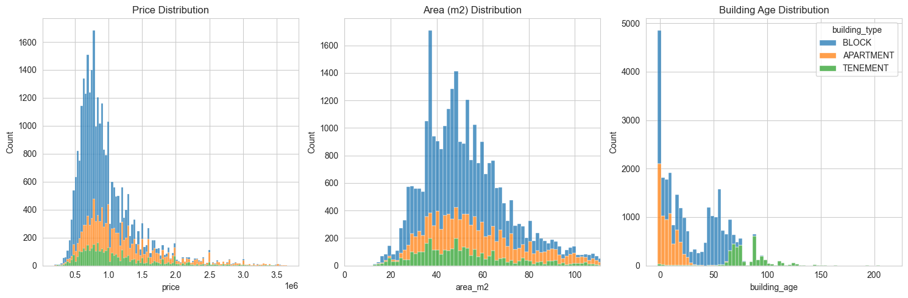
* tenement: kamienica
Notes:
Tenement: kamienica

Slide 19
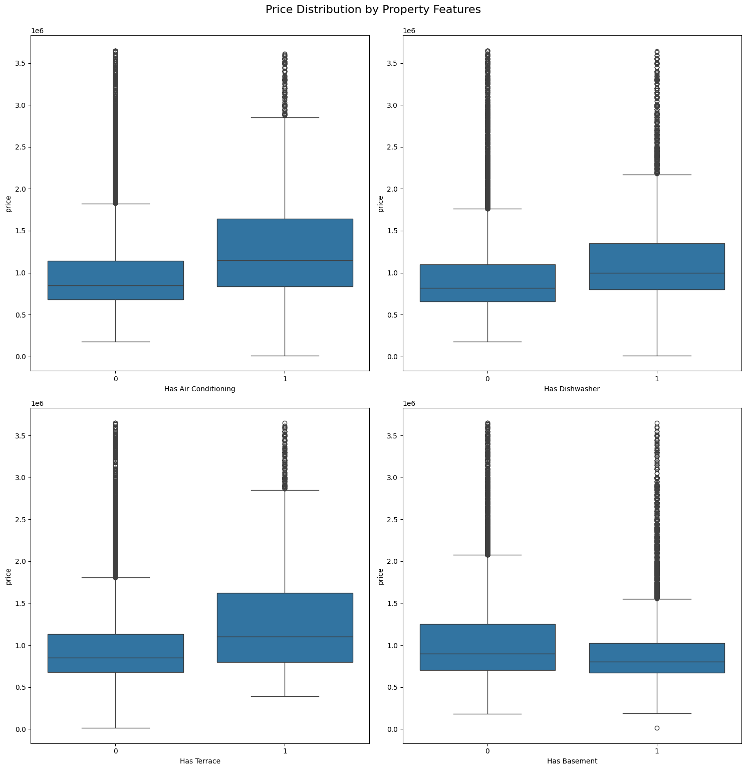
Highlights
Air conditioning: correlated with newer and furnished flats
Dishwasher: correlated with furnished properties
Terrace: correlated with larger and newer properties
Basement: correlated with older properties
Notes:
Has basement: older property, with separate kitchen and doesn’t have lift

Slide 20
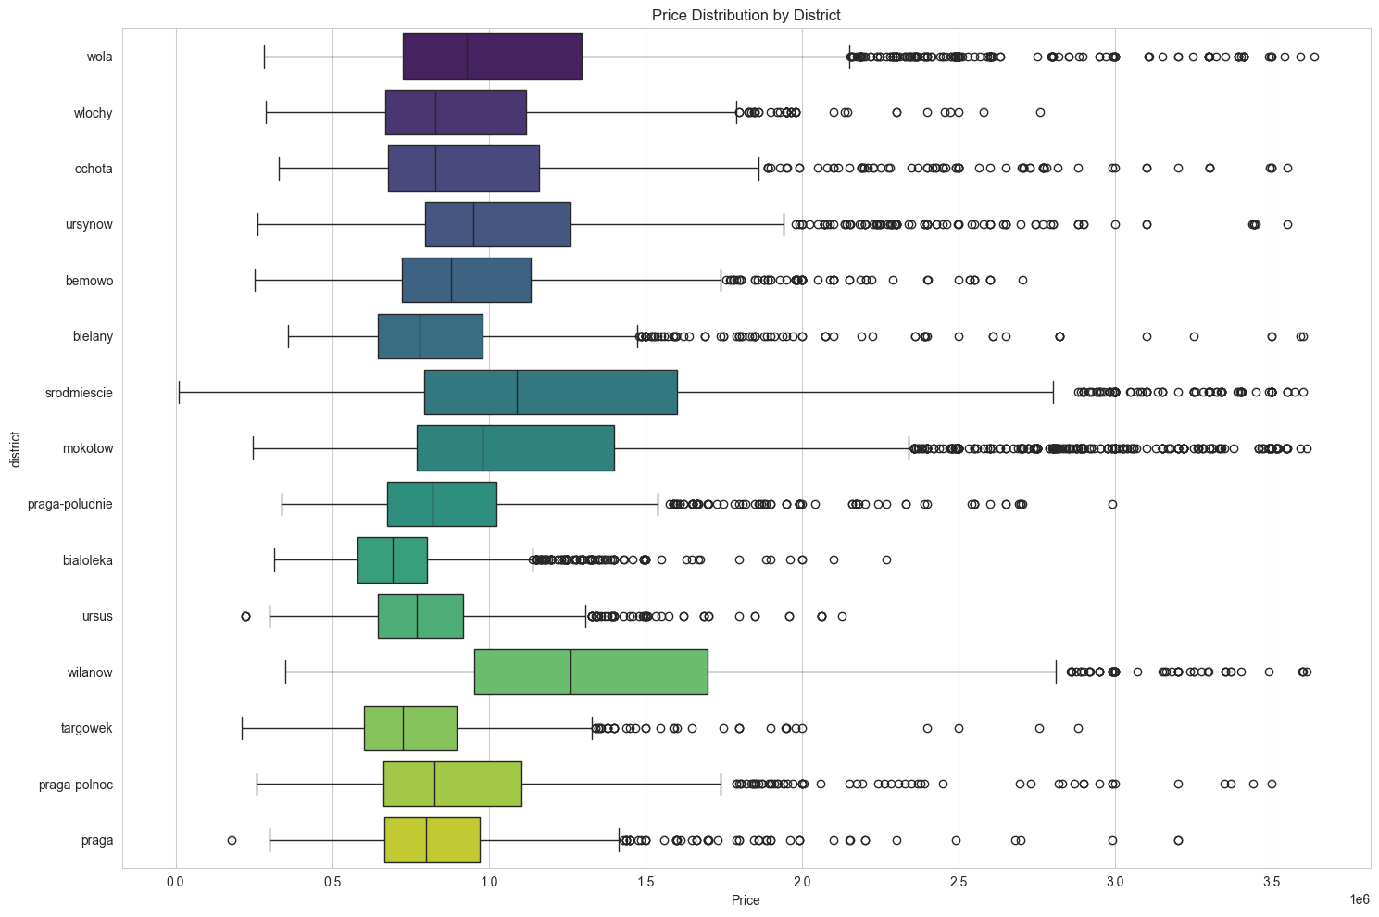
Notes:
Bialoletka

Slide 21
Training/Test Data Division
For splitting the data, I used a 80/20 split.
Top 30 features selected with highest correlation.
Randomized Search CV used for hyperparameter tuning.
50 iterations
metric neg_root_mean_squared_error
cv 5

Slide 22
Comparison of Methods
model | Decision Tree Regressor | XGBoost Regressor | Random Forest Regressor | Ensemble Learning*
RMSE | 209411 | 120715 | 147654 | 131948
R2 | 0.80 | 0.932 | 0.90 | 0.92
MAPE | 0.14 | 0.068 | 0.09 | 0.079
*Ensemble Learning: XGBoost, Random Forest Regressor, GradientBoostingRegressor

Slide 23
Summary and Conclusions
Selected model is XGBoost Regressor due to lower RMSE and MAPE
Improve feature selection methods
Improve imputing methods
Adjust ensemble pipeline
Comparison of performance between training and test seems to indicate overfitting

Slide 24
Thank you!

